Slide 1
Manual Testing Lifecycle
Day 9 – Bootcamp SQA & PM
Muhammad Fahad Bashir

Slide 2
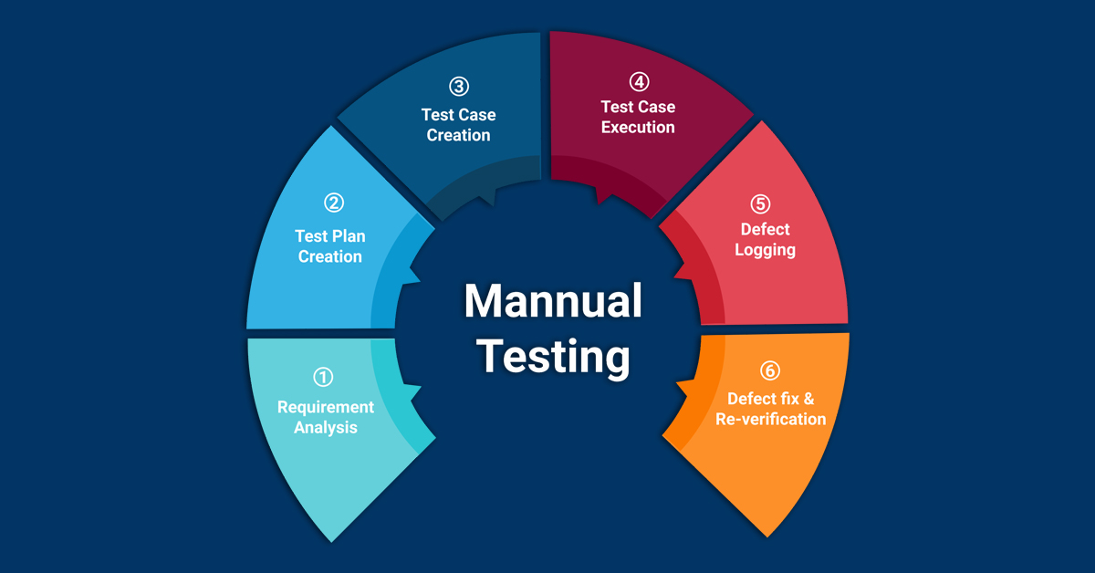
Manual Testing Life cycle
unlike automated testing, it involves a person actively using the software to find bugs and issues.
This hands-on approach helps ensure the software works as intended and meets user needs.

Slide 3
What is Manual Testing
Manual testing is a technique to test the software that is carried out using the functions and features of an application.
In manual software testing, a tester tests the software by following predefined test cases.
In this testing, testers make test cases for the codes, test the software, and give the final report about that software.
Every new application must be manually tested before its testing can be automated.

Slide 4
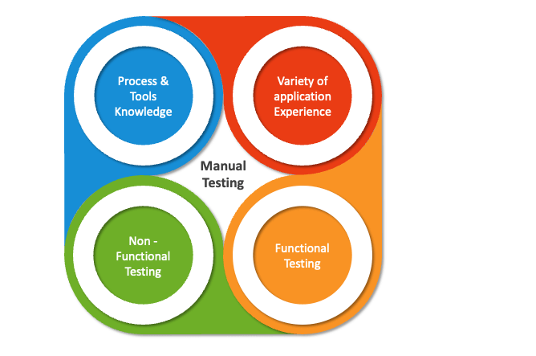
Manual Testing requires more effort than automation testing but is necessary to check automation feasibility.
manual testing relies on predefined test cases and can be time-consuming and prone to human error.

Slide 5
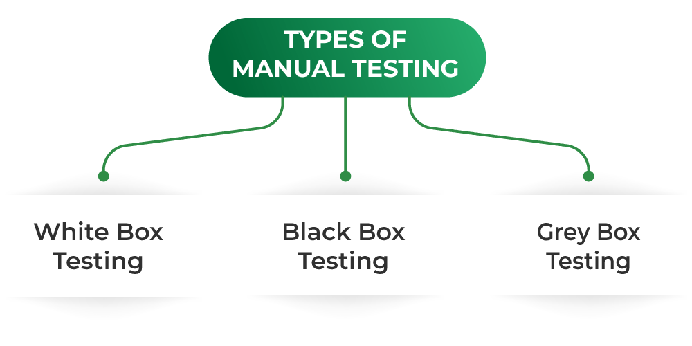
Type of Manual Testing

Slide 6
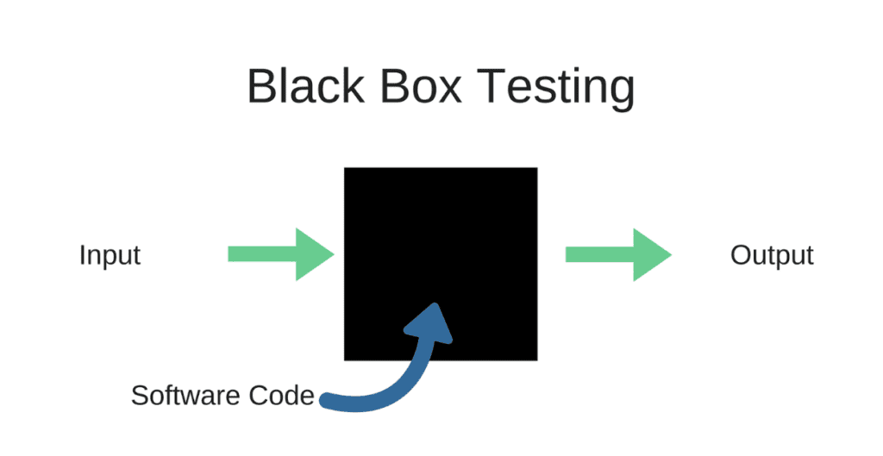
Black Box Testing

Slide 7
Black Box Testing
In Black Box Testing technique, the tester or the QA analyst will only check the functionality of the particular module or particular method or sometimes the entire application by providing the different test cases manually.
Functional testing: In this testing Test engineer checks whether the features of the application work according to the specified requirements.
Non-functional testing: It will focuses on the software all start to end performance, usability, and other quality aspects that do not directly relate to specific functions
Regression testing: This testing is done after any code changes, updates, or bug fixes to verify that the new code does not have negatively impact the existing features of the software which are already working fine.

Slide 8
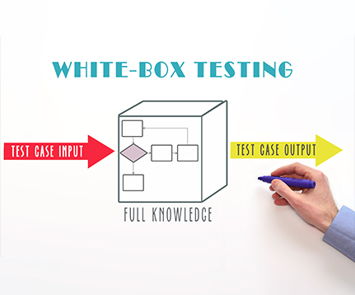
White Box Testing
In White Box Testing technique, the person will check the internal structure of the system like designs, coding, etc., manually.
development team will review the entire coding part line by line to ensure the correctness of the code.
the process is entirely carried out manually and the process is efficient since the checking code or design is manually checked by humans.

Slide 9
White Box Testing
Path Testing: White box testing will be checks all possible execution paths in the program to sure about the each one of the function behaves as expected.
Input and Output Validation: By providing different inputs to a function, white box testing check the function gives the correct output each of the time.
Security Testing: this will focuses on finding security issues in the code.
Loop testing: It will be check that loops (for or while loops) in the program operate correctly and efficiently.
Data Flow Testing: This involves tracking the flow of variables through the program.

Slide 10
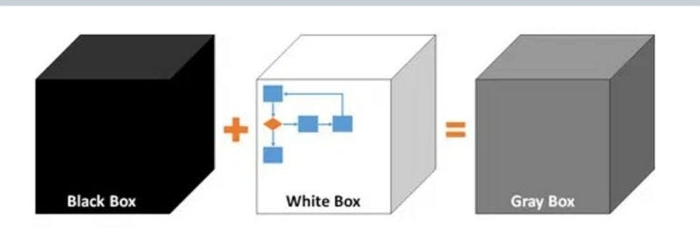
Gray Box Testing
In Gray Box Testing this technique is the combination of both white-box testing and black-box testing.
The internal structure of the application is partially known by the tester.
The tester will check both the internal structure and the functionality of the application manually

Slide 11
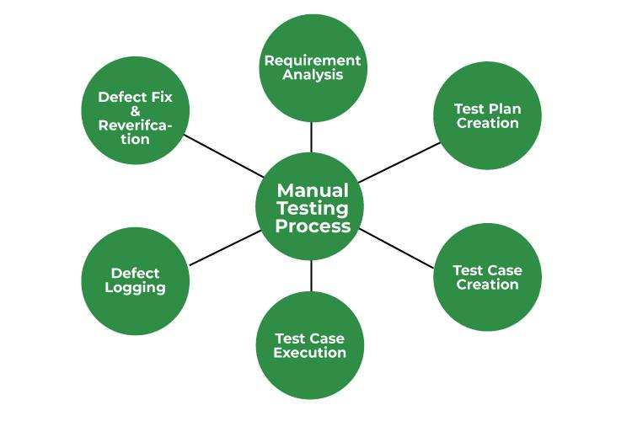
Steps in Manual Testing

Slide 12
Steps of Manual testing
Requirement Analysis: Study the software project documentation, guides, and Application Under Test (AUT). Analyze the requirements from SRS.
Test Plan Creation: Create a test plan covering all the requirements.
Test Case Creation: Design the test cases that cover all the requirements described in the documentation.
Test Case Execution: Review and baseline the test cases with the team lead and client. Execute the test cases on the application under test.
Defect Logging: Detect the bugs, log and report them to the developers.
Defect Fix and Re-verification: When bugs are fixed, again execute the failing test cases to verify they pass.

Slide 13
Tools used for Manual Testing
1. Test Link: It is a web-based test management system that facilitates software quality assurance, and it is one of the most user-friendly programs.
Bugzilla: It is a web-based bug-tracking tool that is developed by Mozilla.
Jira: It is a manual testing tool that helps teams assign, track, report, and manage work and bring teams together.
LoadRunner: It is one of the most widely used performance testing tools. The primary purpose of this tool is to categorize the most prevalent causes of performance problems

Slide 14
Characteristics of Manual Testing
Human Performance: Human testers who use the product the same way as end users conduct manual testing.
Investigative Testing: Exploratory testing, in which testers examine the application without using pre-defined test cases.
Flexibility: Throughout the testing process, testers can adjust to changing conditions and requirements.
Initial Testing: Early in the software development life cycle, even before the program is fully developed, manual testing can be started.
While others are Examining Complex Situations,

Slide 15
Why Need Manual Testing
Bug-free and Stability: The main goal of manual testing is to ensure that the application is bug-free, stable, in conformance with the requirements, and delivers a stable product to the customers.
Familiarity with the product: Manual testing helps the test engineers get more familiar with the product and get an end-user perspective.
Fixing the defects: Manual testing helps to ensure that the defects are fixed by the developer and that retesting has been done on the fixed defects.

Slide 16
Advantages of Manual Testing
Fast and accurate visual feedback: It detects almost every bug in the software application and is used to test the dynamically changing GUI designs like layout, text, etc.
Less expensive: It is less expensive as it does not require any high-level skill or a specific type of tool.
No coding is required: No programming knowledge is required while using the black box testing method. It is easy to learn for the new testers.
Efficient for unplanned changes: Manual testing is suitable in case of unplanned changes to the application, as it can be adopted easily.

Slide 17
Disadvantages of Manual Testing
Less reliable: Manual testing is less reliable as it does not provide testing on all aspects of testing.
Can not be reused: There is a need to develop separate test cases for each new software.
Large human resources required: Manual testing requires numerous human resources, and there are some tasks that can't be performed manually.
Needs experience: The tester needs to know the application well. They develop test cases based on their experience, there is no proof that all the functions are covered or not.
Time-consuming: If the project is large, then the testing process is time-consuming.

Slide 18
Practical Part

Slide 19
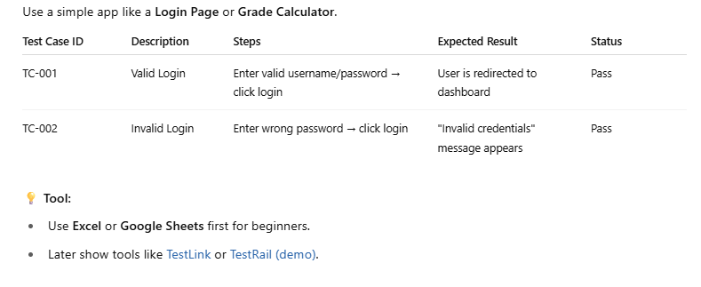
1. Test Case Writing
Objective: Learn how to write test cases clearly for real scenarios.
🎯 Practical: Use a simple app like a Login Page or Grade Calculator.

Slide 20

2. Test Case Execution
Objective: Execute tests and mark as Pass/Fail with actual results.
🎯 Practical: Open your test case sheet or toolRun the app (e.g., your HTML grade calculator)Perform actions based on stepsWrite Actual Result and Status (Pass/Fail)

Slide 21
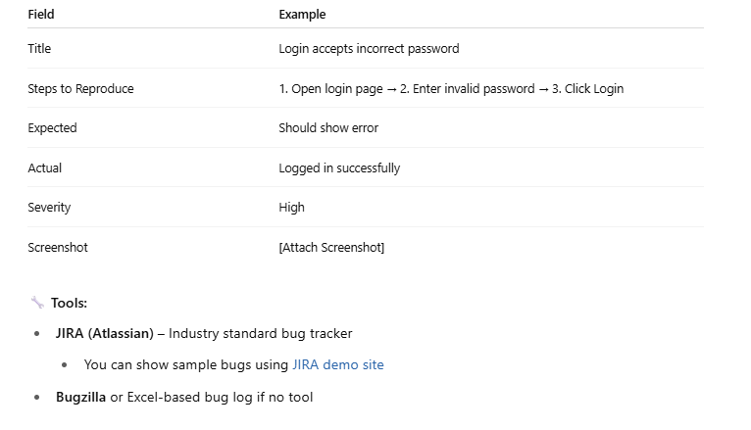
3. Defect Logging
Objective: When a test fails, log the bug with full detail.
🐞 Practical Defect Example (if login accepts wrong password):

Slide 22
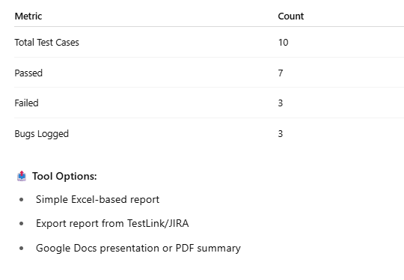
4. Test Reporting
Objective: Report testing results to stakeholders.
📊 What to include:
Total Test Cases
Pass/Fail Summary
Bugs Raised
Screenshots/Logs

